Slide 1
大綱
DATA(features)
EDA (把程式裡面的步驟跟觀察到的東西全部截圖秀出來之類的)
MODELS
重點:RESULTS(比較只用三個最好的模型合併的，跟用全部模型合併的模型 / FEATURE IMPORTANCE / 混淆矩陣)
VOTING(SOFT & HARD), STACKING

Slide 2
Models
Models we use:
(‘XGBoost', XGB_model),
('Random Forest', RF_model),
('Gradient Boosting', GBT_model),
('K Nearest Neighbours', KNN_model),
('Linear Discriminant Analysis', LDA_model),
('Support Vector Machine', SVC_model),
('Naive Bayes', GNB_model),
('Quadratic Discriminant Analysis', QDA_model),
('Logistic Regression', LR_model),
('Neural Network', MLP_model)
這邊講大概用了哪些models，也可以稍微介紹
And we use voting(hard&soft), stacking to merge these models, so we have 13 models in total.

Slide 3
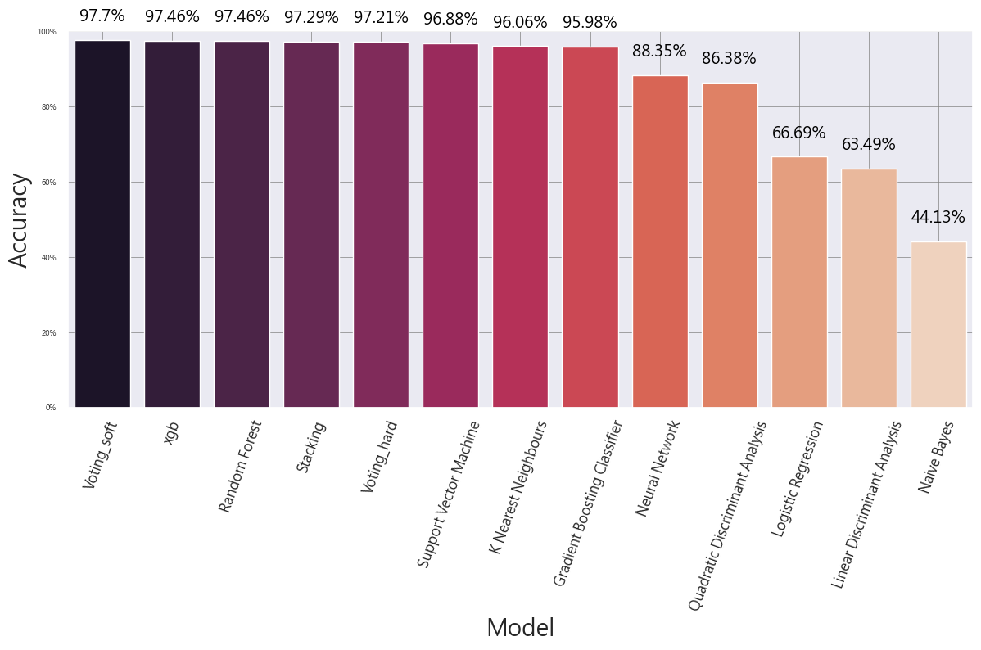
Results
這邊看出最好的三個為rf xgb svm

Slide 4
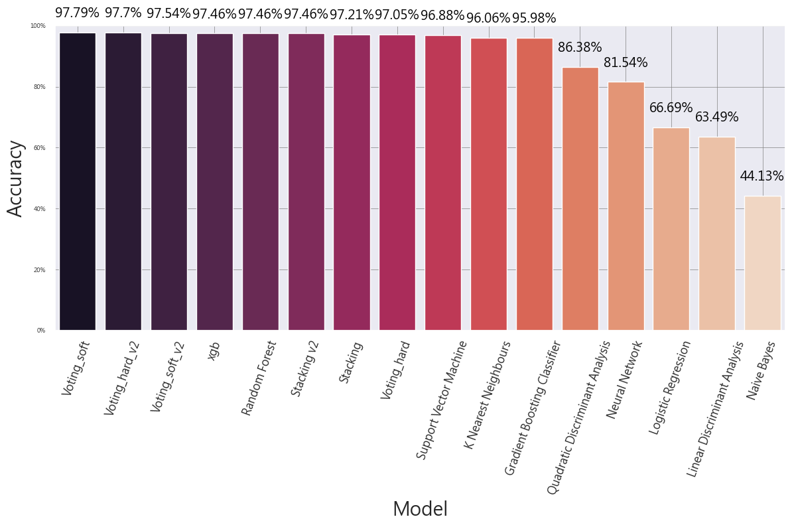
Results
這邊講models的結果，以及accuracy的定義之類的
所以這邊的voting_hard_v2、voting_soft_v2跟stacking_v2是只用最好的三個模型(svm, rf, xgb)合併的，目的用來比較用全部的模型合併跟只用最好的模型合併的模型的效果

